Slide 1

Differential Privacy on graphs
Xiaoyang Wang
Notes:
NOTE:
To change the image on this slide, select the picture and delete it. Then click the Pictures icon in the placeholder to insert your own image.

Slide 2
Graph Analysis
Many datasets can be represented as graphs.[1]
“Friendships” in online social network
Financial transactions
Email communication
Romantic relationships
Privacy is a big issue!
[1]https://www.iacr.org/workshops/tcc2013/slides/8-3.pdf

Slide 3
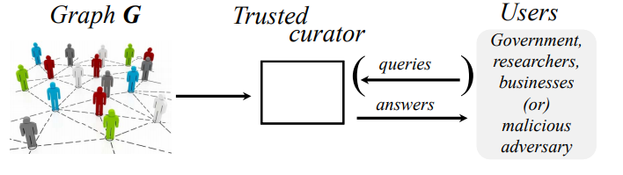
Analyzing Graphs with Node Differential Privacy – TCC 2013
Goal:
Given a graph G
The users can send queries to a trusted curator.
The curator send answers back to users.
The users’ information should not be revealed.
The answer should be relatively accurate.

Slide 4
Differential Privacy
Goal: A change to one person’s data will not significantly affect the output distribution of an analysis procedure.
Example:
Only one person in the world has disease A
Send a query to a hospital and ask whether they have patient with disease A
The answer to the query reveals the presence of the person in the hospital
General method: Add noise.
For graph data:
Node: Output doesn’t reveal the inclusion or removal of a node and all its adjacent edge. (Picked)
Edge: Output doesn’t reveal the inclusion or removal of an edge.
Problem: Node-private algorithm can’t provide a desirable accuracy.
Notes:
The problem in this paper is that

Slide 5

Differential Privacy on Graph
Goal:
Find a node-private algorithm that is robust to the insertion of a new node in the graph.
In other words, the output doesn’t change much after graph G is transformed to G’
Challenge:
The properties of a sparse graph can be altered dramatically by the insertion of a well-connected node.
Example:
Linear Queries
h(i) = i/2, we have F_{h} counting the number of edges in a graph.
In a sparse graph, the value of F_{h} will change a lot if we add or remove a node with high degree.
Notes:
The paper doesn’t mention deletion.

Slide 6
Differential Privacy - Preliminaries
(epsilon)-differential privacy:
Epsilon is a positive real number
A is a randomized algorithm that takes a dataset as input
Dataset D₁ and D₂ differs on a single element
S is possible outputs
Example:
Only one person in the world has disease A
D is the dataset contains the patient with disease A
D’ is the modified dataset doesn’t contain the patient with disease A
The Pr(D) = 1.0, Pr(D’) = 0.0
Even infinitely large for epsilon is not enough
Notes:
An algorithm is differentially private if an observer seeing its output cannot tell if an individual's information was used in the computation. (?)
An extreme case: Assume you are the only person in the world has a rare disease A. I send a query to a hospital’s database to ask whether they have any patient with disease A, if they have, I know it’s you. Your information is leaked in this case.
If your data is changed, the output of the query is changed too.
S is all possible subset of the image of a function.

Slide 7




Differential Privacy – On Graphs
(epsilon, delta)-differential privacy:
Global Sensitivity:
Laplace Mechanism: (p is the dimension of output)
Local Sensitivity:
Smooth Bound:
Calibrating Noise to Smooth Bounds(based on Cauchy distribution):
Let S be a beta-smooth bound on LS
If
We have epsilon-differentially private algorithm
Notes:
An algorithm is differentially private if an observer seeing its output cannot tell if an individual's information was used in the computation. (?)
An extreme case: Assume you are the only person in the world has a rare disease A. I send a query to a hospital’s database to ask whether they have any patient with disease A, if they have, I know it’s you. Your information is leaked in this case.
If your data is changed, the output of the query is changed too.
Delta is simply a relaxation.
Local sensitivity, Graph G is a given graph. In global sensitivity, G is not defined. A paper showed the magnitude of noise will leak user information.
->Smooth bound.
If you add noise based on the above methods, your addictive error will increase with sensitivity.
So how can we get rid of this problem?

Slide 8
Solutions
Main idea: “Project” the graph onto a set of bounded-degree graphs.
On bounded-degree graph, node-private algorithm doesn’t suffer from the insertion of a well-connected node problem. In other words, the node-private algorithm is less sensitive.
With a carefully chosen degree threshold, the graph transformation loses relatively little information.
Difficulty: The projection itself may be very sensitive.
Overcome the difficulty with two techniques:
For a certain class of statistics, designed tailored projection operators using Lipschitz extensions
Analyze the “native” projection that simply discards high-degree nodes with efficient algorithms bounding the “local sensitivity” of this projection.

Slide 9
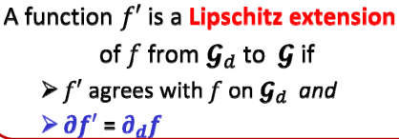

Lipschitz Extension
Definition:
f is the original function
f’ is a Lipschitz extension of f
is family of all graphs
is family of graphs of degree <= d
is sensitivity of f’
is sensitivity of f in
For each function f, we can manually design a Lipschitz extension of it.
The Lipschitz extension function has a lower sensitivity
Then use it to approximate the original function in the projected space

Slide 10


Flow-based Lipschitz Extension
The flow graph of G with parameter D, a source s and a sink t is a directed graph.
The flow graph has capacitated edges:
Edges of capacity D from the source s to all nodes in V_{l}
Edges of capacity D from all nodes in Vr to the sink t
Unit-capacity edges (u_{l}, v_{r}) for all edges {u, v} of G
Two properties of this projection:
The global node sensitivity
For all graphs G, the value v_{fl}(G) <= 2f_{e}(G), v_{fl}(G) denotes the value of the maximum flow in the flow graph of G, f_{e}(G) be the number of edges in G. Moreover, if G is D-bounded then v_{fl}(G) = 2f_{e}(G).
The original function f is f_{e}(G), which is counting the edge.
The sensitivity of it is D in

Slide 11
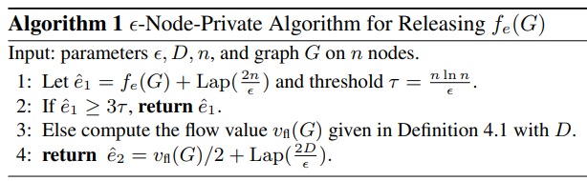




Flow-based Lipschitz Extension – Algorithm for Releasing the Number of Edges
Algorithm
Lemma:
If , with probability at least 1 − 1/ln(n),
the output error is bounded
If and G satisfies α-decay for α > 1, D > ¯d,
3*Tau in algorithm 1 seem an average of and , but the paper didn’t elaborate more on this point.
Notes:
α-decay means the tail of the degree distribution can’t be too long
N is number of nodes

Slide 12
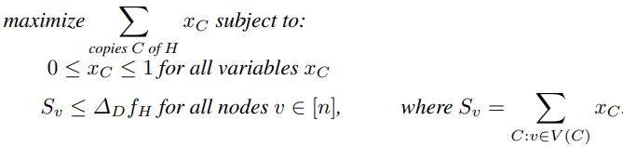
Linear Programming-based Lipschitz Extension
LP-based projection is used to release the number of a specified small template graph H in the input graph G. (sub-graph counts)
Manually crafted another Lipschitz extension for subgraph matching in a similar way.

Slide 13


Generic Reduction Method
What if we simply discard the nodes with large degrees via truncation?
The local sensitive can be computed via multiplying the sensitivity of query function and truncation function
Naïve truncation has high local sensitivity
(smooth upper bound on the local sensitivity)
l is the number of nodes in degree range , beta is the range
The bound depends on the number of nodes immediately around the cutoff D, may lead to large sensitivity

Slide 14



Generic Reduction Method
Improvement:
Randomizing the cutoff- picks a random threshold in a range of bounded by a constant multiple of D
The smooth sensitivity of naive truncation is (likely to be) close to the average number of nodes of a random degree in the range -
Saving a factor of roughly D in the introduced noise
P_{G}(D) is the fraction of nodes in G of degree greater than D
is uniformly random
in the range

Slide 15
Remark
Proposed two general method:
Lipschitz extension
Generic reduction
To use Lipschitz extension, design a Lipschitz extension function for each analytics task.
Generic Reduction Method doesn’t require manual effort but seemingly has a higher error

Slide 16
Generating Synthetic Decentralized Social Graph with Local Differential Privacy – CCS 2017
As title said
Current approach doesn’t give enough accuracy due to
excessive noise injection
inability to retain informative graph structure

Slide 17
Straw-man Approach 1 – Randomized Neighbor List
Given a social graph G, a set of users U = {u₁, …, u_{n}}, each user u in the set maintains a binary vector to represent local neighbor list.
When sending the list to the data curator, each user perturb entries in their list with a probability .
Consider the Enron email graph (detailed in section 5), whose original density is 0.01%. Even with a small bit flipping probability p = 0.01, the expected density of the graph after neighbor list randomization would become 2%, an increase of 200 times

Slide 18

Straw-man Approach 2 – Degree-based Graph Generation
DCG feeds graph statistics information such as node degrees into a social graph model to generate a graph.
Using DGG, each user calculates his node degree, perturbs the degree under ϵ-edge differential privacy.
For reasonably large values of ϵ, the perturbed degree is expected to be close to its true value, since the noise injected with the Laplace mechanism has a variance of for binary input

Slide 19
Observation from Straw-man Approaches
RNL
Collects fine-grained information (i.e., neighbor lists)
Pays the price of heavy perturbations required to satisfy local differential privacy.
DGG
Collects exclusively node degrees, it loses all other information of the underlying graph
Although DGG suffers less from perturbations noise

Slide 20
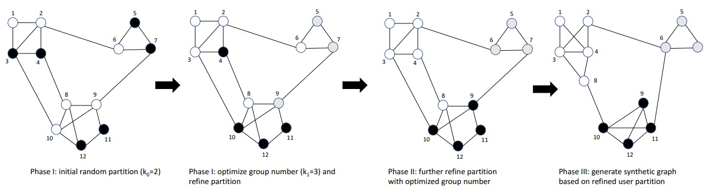
LDPGen - Overview
Try to achieve a balance between noise(RNL) and information loss(DGG)
Basic idea:
Partition the users into groups
Collect their degree vector(defined as number of neighbors)
Use collected degree vector to generate graph

Slide 21

LDPGen – Phase I: initial grouping
Steps:
Partition users into k equal-sized groups
Compute degree vectors
Add Laplace noise to degree vectors
To get a good partition, we need to decide the value of k and the partition method.
Proposed an optimization-based approach the achieve better performance:
Objective function: where d is the distance between neighbor vectosr, is the distance
between noisy degree vector

Slide 22
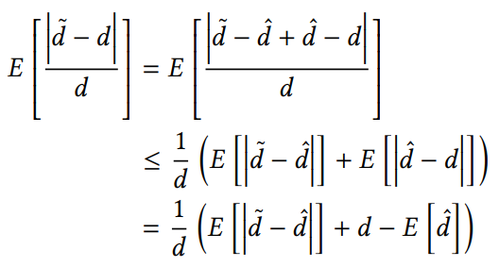


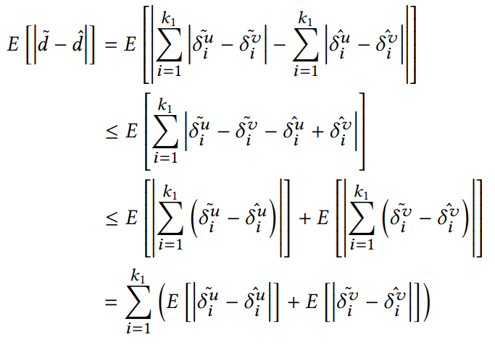
LDPGen – Phase I Noise analysis
Objective function:
Noise perturbation:
Consider Laplace distribution:
Expected error:
Much smaller than RNL

Slide 23



LDPGen – Phase I Optimal Group Number
The number of partitions:
Weighted sum of optimal k₁ for each node based on their degree
Optimal k1 for node with degree d - L1 distances between their neighbor lists
For nodes with the same degree η, we estimate their underlying L1 distance d heuristically
The data curator runs the standard k-mean algorithm to cluster users into k1 groups

Slide 24
LDPGen – Phase II: grouping refinement.
Performing k-mean clustering based on noisy degree vector at the beginning of Phase II.

Slide 25
LDPGen – Phase III: graph generation
Adapts BTER model to generate a synthetic social graph.

Slide 26
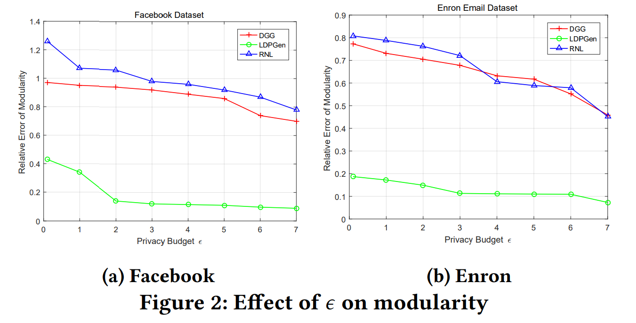
LDPGen – Experiment

Slide 27
Remark
Proposed a three-phase generalized processing pipeline to generate synthetic graph from decentralized graphs while preserving privacy.
The core of this algorithm is to find a good partition and an optimal group number.

